Slide 1
Introduction to Statistical Methods
Dr Y V K Ravi Kumar, BITS- Pilani

Slide 2
Session 4: Random Variables
II Semester 2019 -20(Aug 2020)

Slide 3
Agenda
Random variable
Discrete Random variable
Continuous random variable
3

Slide 4
Random variables

Slide 5









Slide 6
Random Variables
For a given sample space S of some experiment , a random variable(rv) is any rule that associates a number with each outcome in S. in mathematical language , a random variable is a function whose domain is the sample space and whose range is the set of real numbers a variable hat assumes numerical values associated with the random outcome of an experiment, where one (and only one) numerical value is assigned to each sample point.

Slide 7
Bernoulli Random Variable
Any random variable whose only possible values are 0 and 1 is called a Bernoulli random variable

Slide 8
Random Variables
A random variable can be classified as being either discrete or continuous depending on the numerical values it assumes.
A discrete random variable is an rv whose possible values either constitute a finite set or else can be listed in an infinite sequence (“countably infinite”)
A continuous random variable may assume any numerical value in an interval or collection of intervals.

Slide 9


Types of Random Variables
Discrete random variables
Number of sales
Number of calls
Shares of stock
People in line
Mistakes per page
Continuous random variables
Length
Depth
Volume
Time
Weight

Slide 10












Slide 11
Probability Distribution for Discrete Random Variables
The probability distribution (or probability mass function) of a discrete random variable is a graph, table or formula that specifies the probability associated with each possible outcome the random variable can assume.
p(x) ≥ 0 for all values of x
Σp(x) = 1

Slide 12
Probability Distribution
Discrete distribution
X = No. of defectives
X | 0 | 1 | 2 | 3
P(X=x) | 0.614 | 0.324 | 0.057 | 0.003

Slide 13
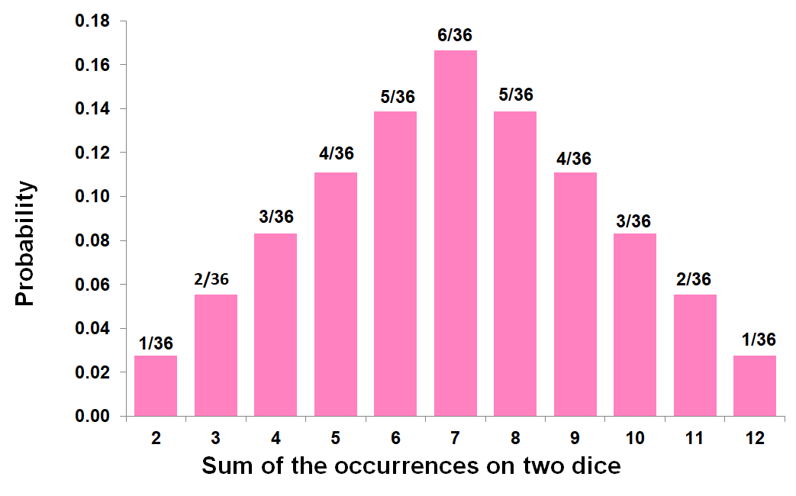
Probability Distribution
Discrete distribution
Example 2:
Let X denote the random variable that is defined as the sum of two fair dice, then,
X=x | 2 | 3 | 4 | 5 | 6 | 7 | 8 | 9 | 10 | 11 | 12
P(X=x) | 1/36 | 2/36 | 3/36 | 4/36 | 5/36 | 6/36 | 5/36 | 4/36 | 3/36 | 2/36 | 1/36

Slide 14
Example
Six lots of components are ready to be shipped by a certain supplier. The number of defective components in each lot is follows
Lot | 1 | 2 | 3 | 4 | 5
No of Defectives | 02 | 0 | 1 | 2 | 0

Slide 15
Expected Values of Discrete Random Variables
The mean, or expected value, of a discrete random variable is

Slide 16
Expected Values of Discrete Random Variables
The variance of a discrete random variable x is
The standard deviation of a discrete random variable x is

Slide 18
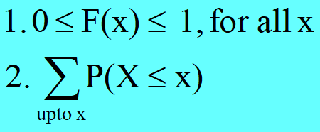
Probability Distribution
Cumulative Distribution Function
Let p(x) =P(X=x) is called a (discrete) probability distribution.
Let F(x) = P(X ≤ x). F(x) is called the Cumulative Distribution Function or Distribution Function (DF) of the discrete random variable X. F(x) has the following properties

Slide 19
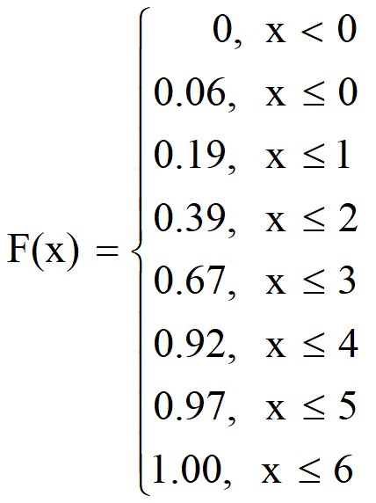
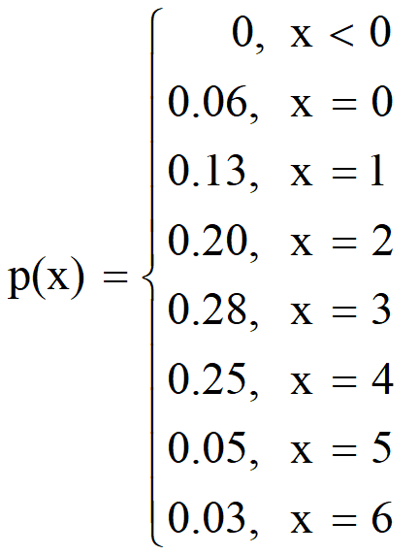
Statistical Methods for Data Science
Probability Distribution
Cumulative Distribution Function
Find the probability mass function from a given
distribution function of X
P(X) = F(X) – F(X-1)

Slide 20
Statistical Methods for Data Science
Probability Distribution
Cumulative Distribution Function
No. of defective RAM chips | Probability | Cumulative probability
0 | 0.125 | 0.125
1 | 0.375 | 0.500
2 | 0.375 | 0.875
3 | 0.125 | 1.000
Total | 1

Slide 21
Random variable
Probability Distribution
A random variable is a real valued function defined on the sample space Ω
With the introduction of X we can write the probabilities as
p(0) = P(X=0) = 0.0625
p(1) = P(X=1) = 0.2500
p(2) = P(X=2) = 0.3750
p(3) = P(X=3) = 0.2500
p(4) = P(x=4) = 0.0625 such that
p(0) + p(1) + p(2) + p(3) + p(4) = 1
and each p(x) ≥ 0, x = 0, 1, 2, 3, 4
Ω
X: Ω→R
R
0
1
2
3
4
0.0625
0.2500
0.3750

Slide 22
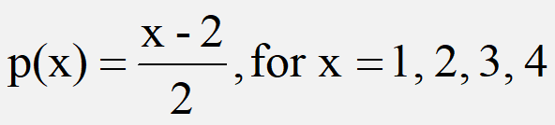

Check whether the following can serve as
Probability distributions
For what value of
c, this can be a
probability mass
function (pmf)?
Probability Distribution
Discrete distribution
Example
No
Yes
with
c =1/30

Slide 23
Statistical Methods for Data Science
Probability Distribution
Discrete distribution function
Probability distributions can be estimated from relative frequencies. Consider the discrete (countable) number of televisions per household (X) from India survey data …
No. of televisions | No. of households | X | P(x)
0 | 1,218 | 0 | 0.012
1 | 32,379 | 1 | 0.319
2 | 37,961 | 2 | 0.374
3 | 19,387 | 3 | 0.191
4 | 7,714 | 4 | 0.076
5 | 2,842 | 5 | 0.028
Total | 101,501 |  | 1.000
1,218 ÷ 101,501
= 0.012
e.g. P(X=4) = P(4) = 0.076 =7.6%

Slide 24
Probability Distribution
Discrete distribution function
What is the probability there is at least one television but no more than three in any given household?
No. of televisions | No. of households | X | P(x)
0 | 1,218 | 0 | 0.012
1 | 32,379 | 1 | 0.319
2 | 37,961 | 2 | 0.374
3 | 19,387 | 3 | 0.191
4 | 7,714 | 4 | 0.076
5 | 2,842 | 5 | 0.028
Total | 101,501 |  | 1.000
“at least one television but no more than three”
P(1 ≤ X ≤ 3) = P(1) + P(2) + P(3) = 0.319 + 0.374 + 0.191 = 0.884

Slide 25









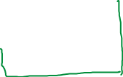



Slide 26








Slide 27















Slide 28


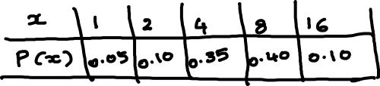

Slide 29


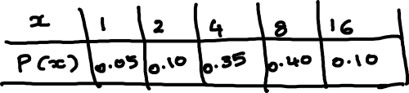

Slide 30





Slide 31

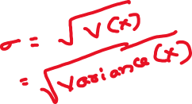

Slide 32
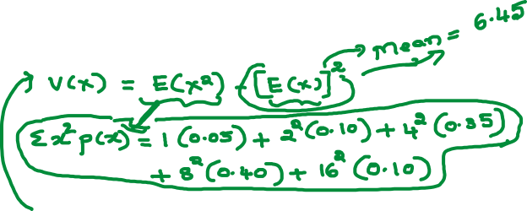

Slide 37


Slide 39
Statistical Methods for Data Science
Probability Distribution
Expected value and Variance
Let X be a discrete random variable having the probability mass function
X = x | 0 | 1 | 2 | 3 | 4 | 5 | 6 | 7
# Registered | 150 | 450 | 1950 | 3750 | k | 2550 | 1500 | 300
Find the value of k
Find the probability distribution function of X
Calculate E(X) and V(X)
Assume N = 15000

Slide 40
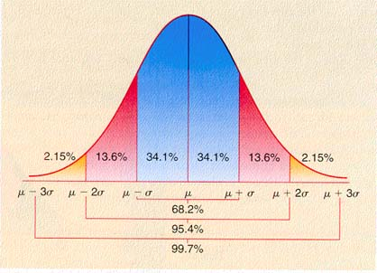
Thank you

